Slide 1
Vimeo
Presented by:
Zaidi Soukayna
Zakaria Fechtali

Slide 2
plan
Presentation of our client and their product
the needs of our client and their requirements
Analysing the color schemes ,fonts and the choice of the elements and the conception realised
Translating the model to html and css

Slide 3
vimera
is a company that Vimera provides professional digital cameras and offers training for photographers to excel their careers

Slide 4
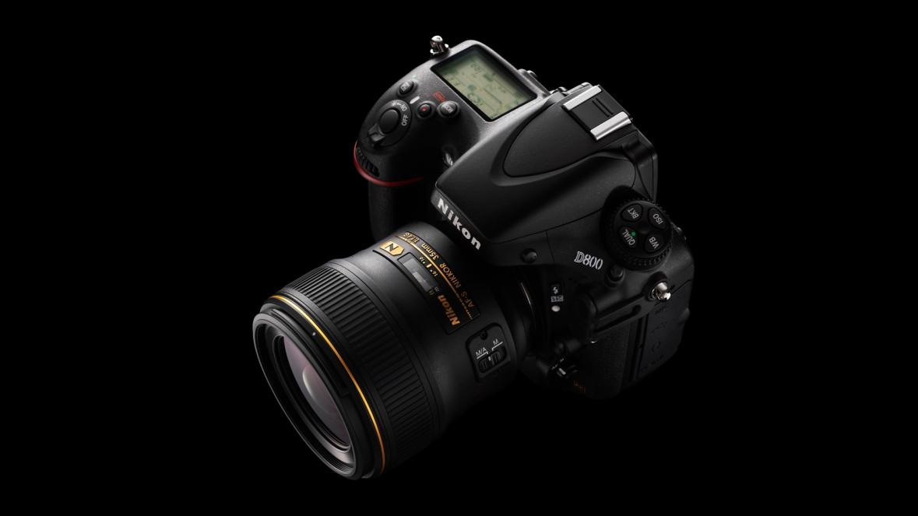
1.
Their product
Camera Vimera 4000 D
It ‘s a Full-frame interchangeable camera for amazing stills and rich video.
They are proposing a price of $2,699.99
Instead of $3,699.99

Slide 5
Our client needs
A landing page for their first product for Mobile phones and Desktop
A smooth design for the website
Modern color scheme
Clear call to action (add to card) The design relies on pictures since their product is a camera
Add in the footer the reviews of their clients
Their main audience are photographers,vloggers and Youtubers

Slide 6
Our BIG CONCEPT
Bring the attention of your audience over high quality pictures since the company produces Camera

Slide 7
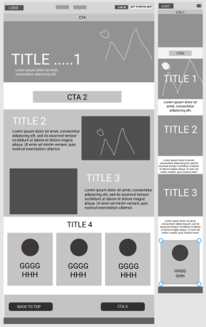
Based on our client needs we made this wireframe for desktop and mobile

Slide 8
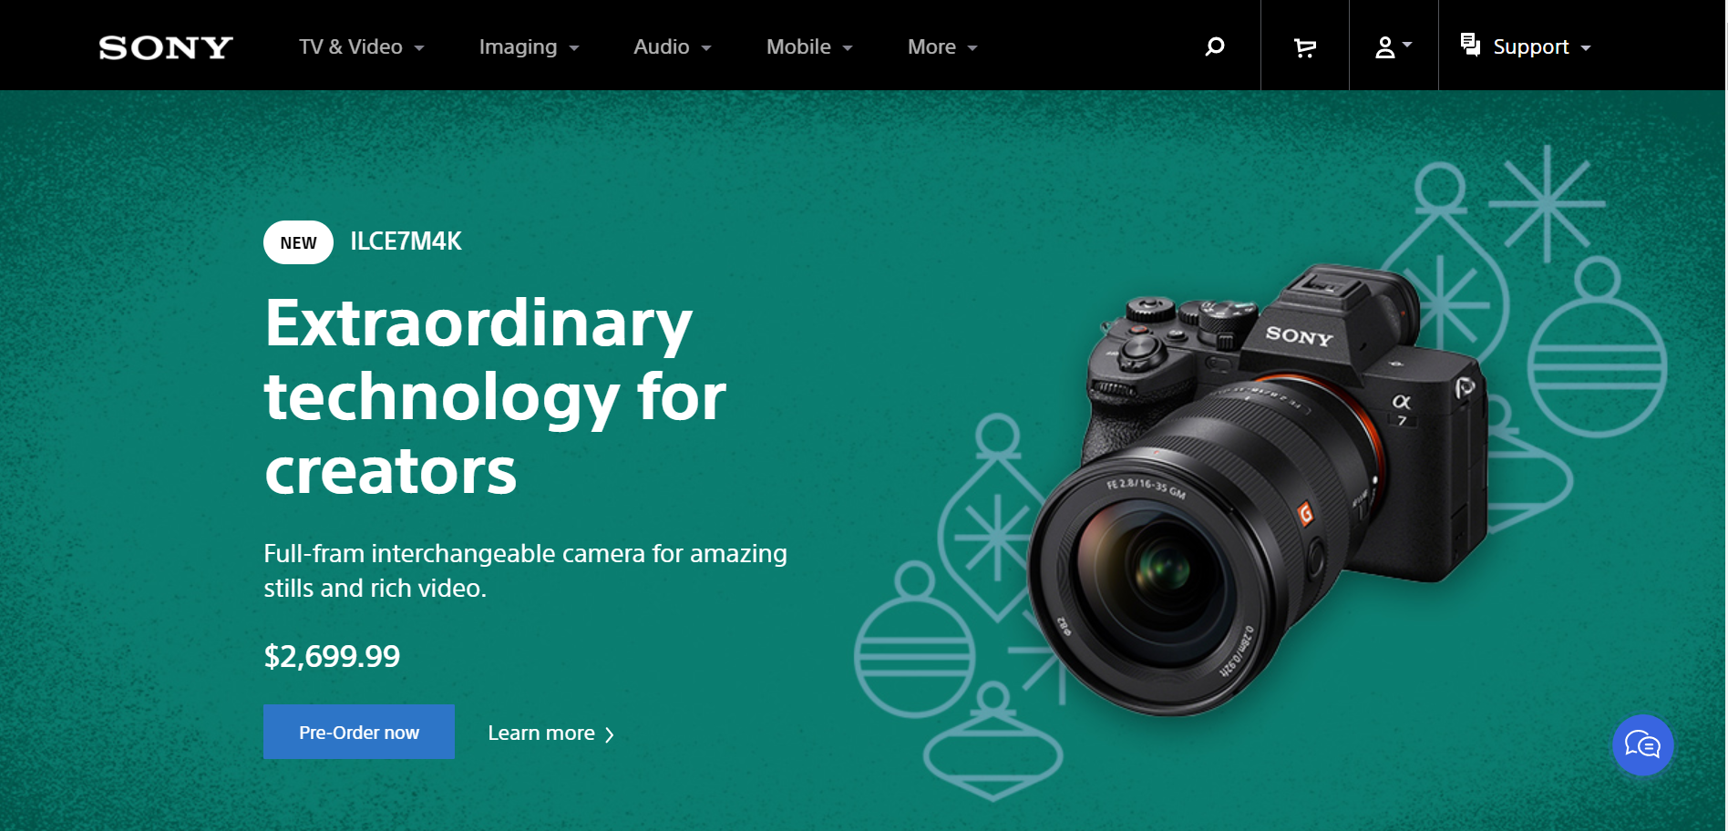
Our inspiring frame was sony landing page

Slide 9
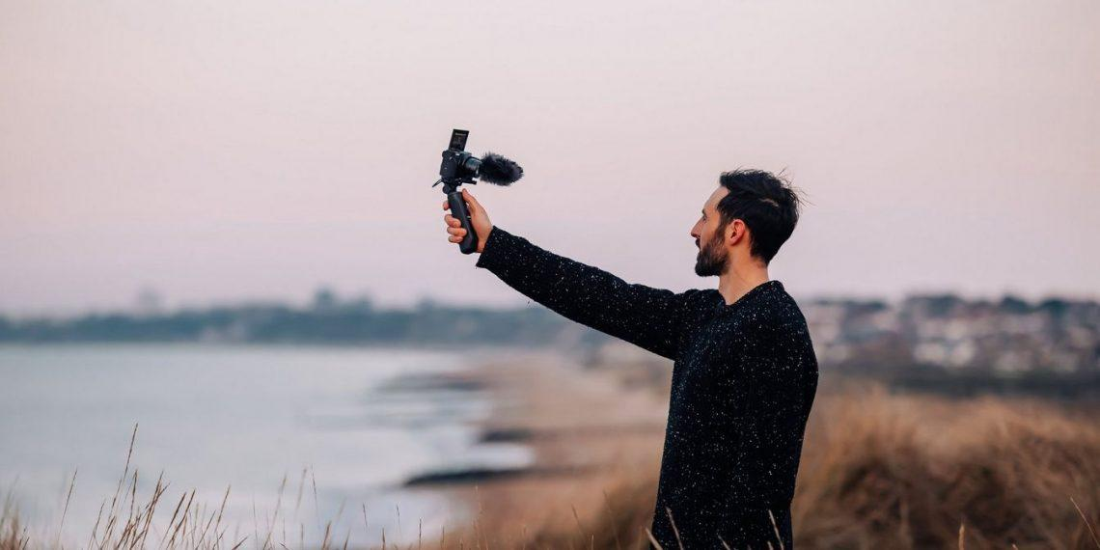

After meeting with the client we choose those picture to be displayed on the page:

Slide 10
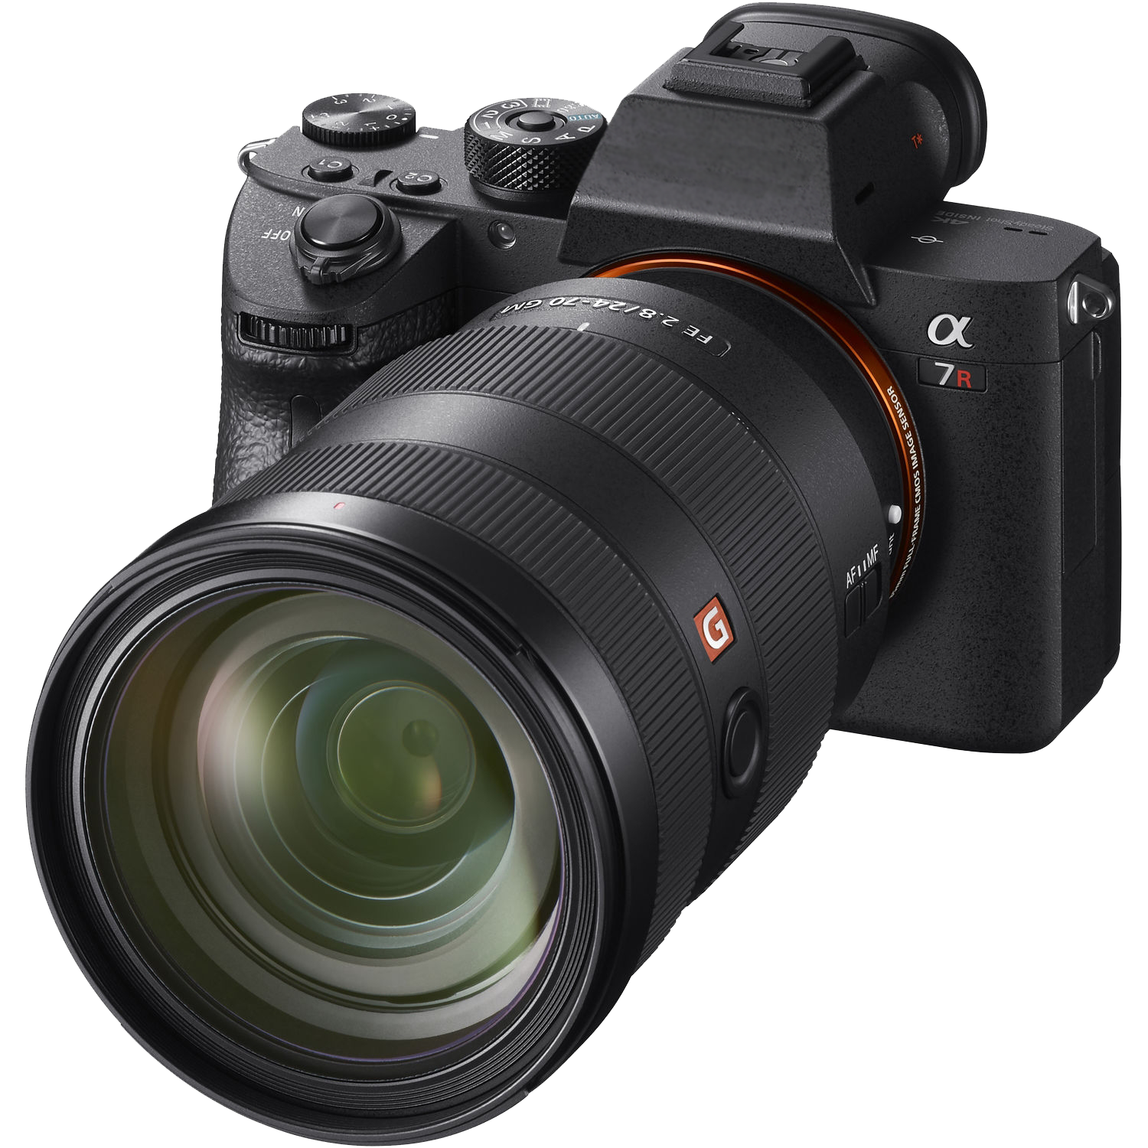
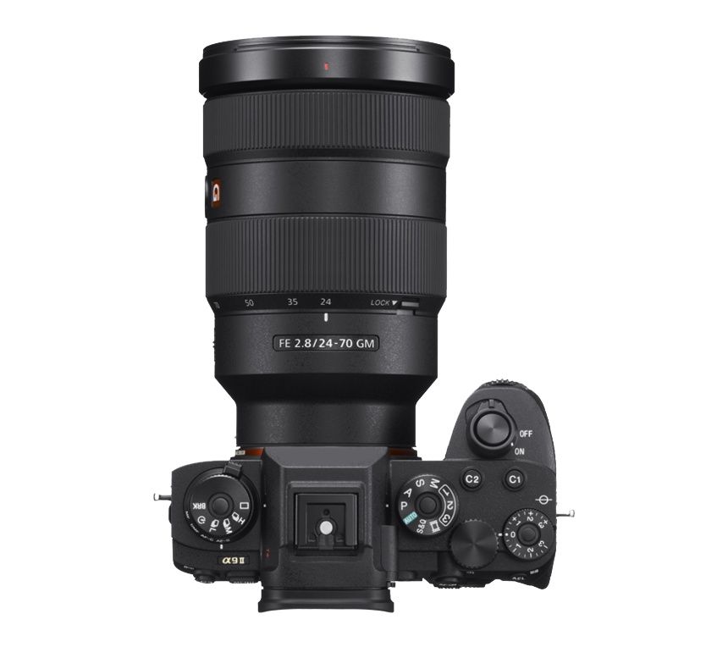
Vimera D4000

Slide 11
I
Color scheme chosen :
Black
Associated with power, elegance, formality, death, evil, and mystery.
A mysterious color associated with fear and the unknown (black holes).
Usually has a negative connotation (blacklist, black humor, ‘black death’).
Denotes strength and authority; it is considered to be a very formal, elegant, and prestigious color.
The symbol of grief.
White
Associated with light, goodness, innocence, purity, and virginity.
Considered to be the color of perfection.
Signifies safety, purity, and cleanliness.
Usually has a positive connotation.
Can represent a successful beginning.
Depicts faith and purity.
Red
Associated with energy, war, danger, strength, power, determination as well as passion, desire, and love.
Enhances human metabolism, increases respiration rate, and raises blood pressure.
It attracts attention more than any other color, at times signifying danger.

Slide 12
TECHNOLOGIE THAT WE WILL BE WORKING WITH :
HTML: HyperText Markup Language, HTML, refers to a type of descriptive computer language. ... HTML is what allows a web designer to manage the way the content of his web pages is displayed on a screen, via the browser.
CSS: CSS, for Cascading Style Sheets, is a computer language used on the Internet for formatting files and HTML pages.
Media query is a CSS technique introduced in CSS3. It uses the @media rule to include a block of CSS properties only if a certain condition is true.
Figma to design the wireframe and the model

Slide 13
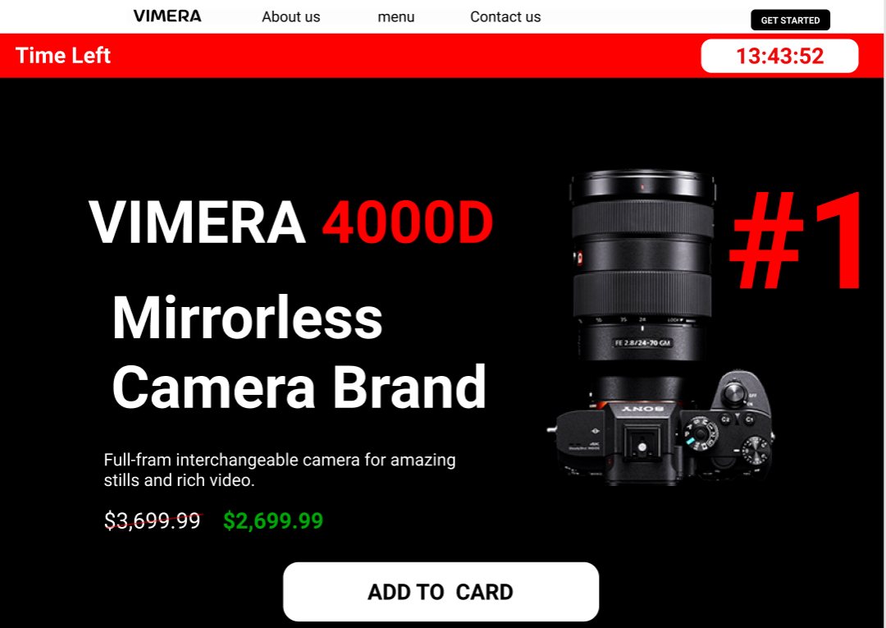
After meeting up with the client we made this Model on figma
We putted in the header a navigation bar another nav to indicate the time left before their promo ends
And a call to action
A picture of the camera and their feaatures

Slide 14

We putted a picture taken by Vimera D-4000
And added the text suggested by the client
Page :2

Slide 15
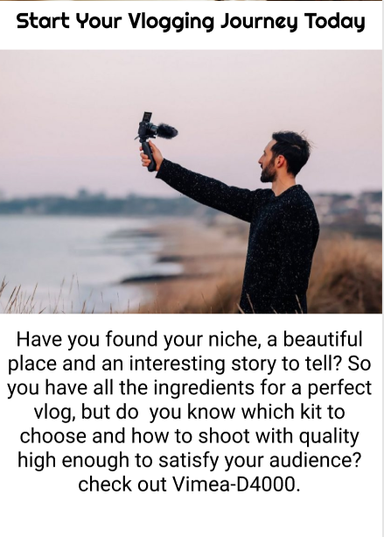
We added a picture of our main target vloggers and a little message
To beginner vloggers who looks for a suitable camera for their needs and vimera D 4000 will cover them
Page : 3

Slide 16
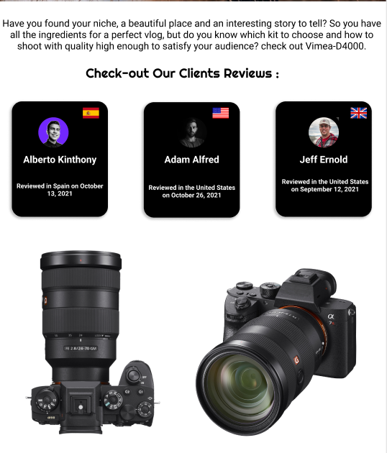
IN THE FOOTER
We added the social proof
Three recommendation
And other pictures of the camera and a call to action
“Add to card”.

Slide 17
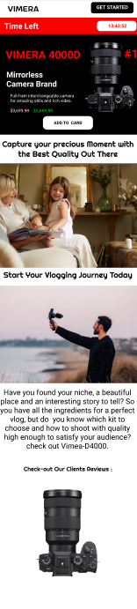
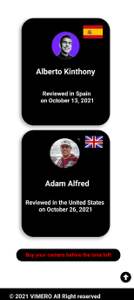
This is the mobile version

Slide 18
Task: translate the header and the body to html and css and make the page responsive to mobile.
Assigned to Soukayna

Slide 19
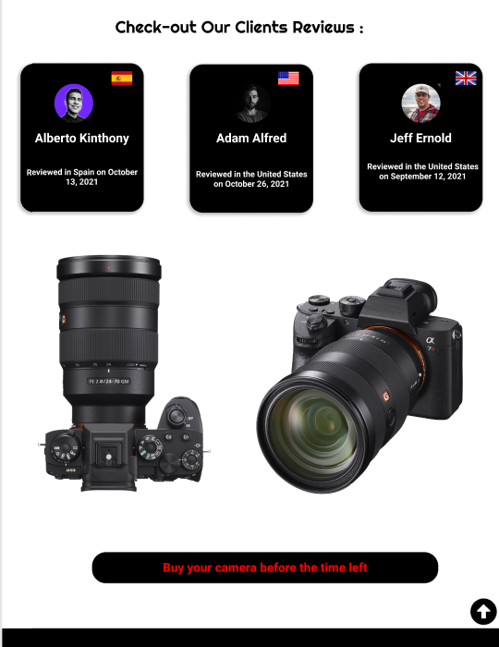
Task : translate reviews and footer to html and css . and use Media query to make it responsive to mobile
Assigned to Zakaria

Slide 20
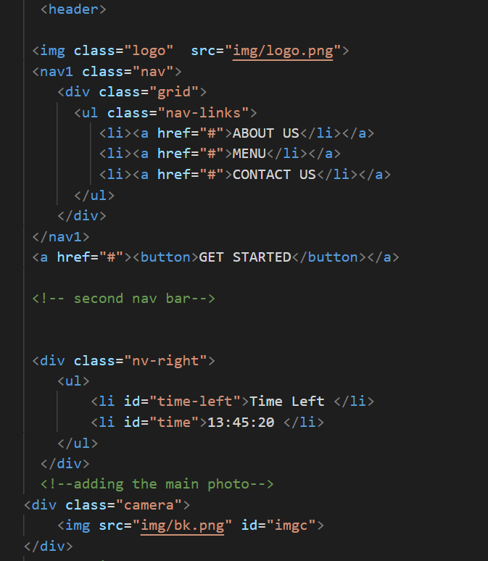
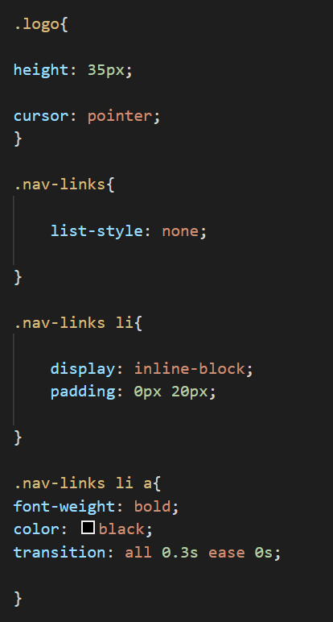
Translating the header to html and css

Slide 21
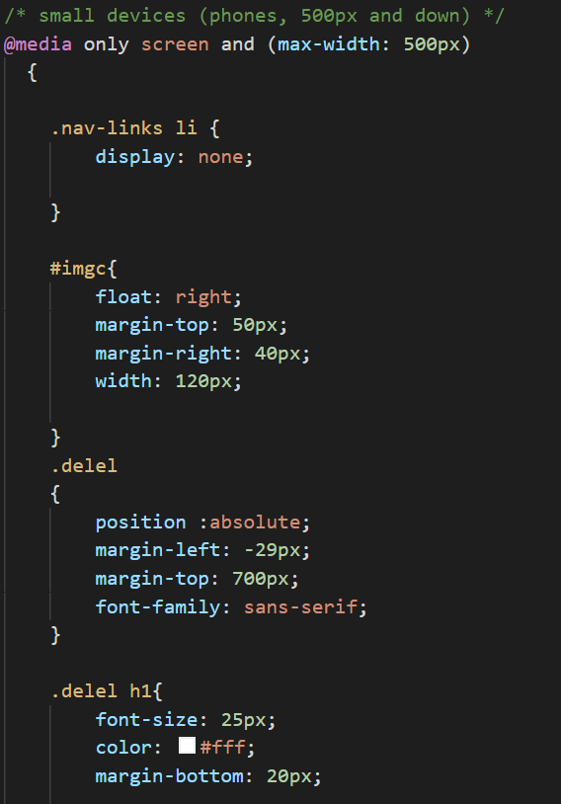
Media query

Slide 22
Translating the footer into html and css

Slide 23
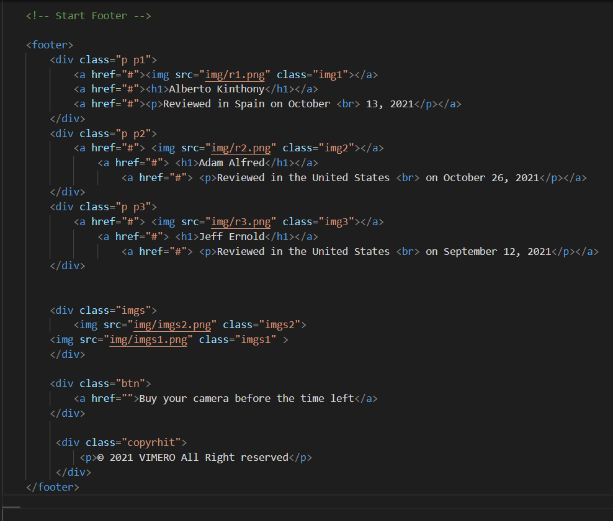
HTML

Slide 24
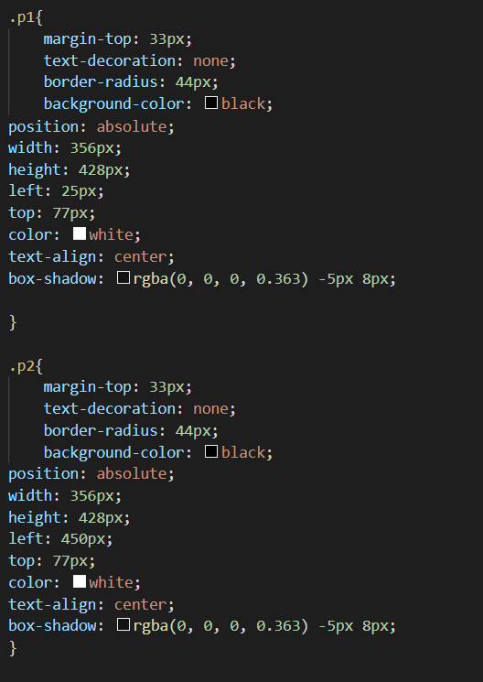
CSS

Slide 25
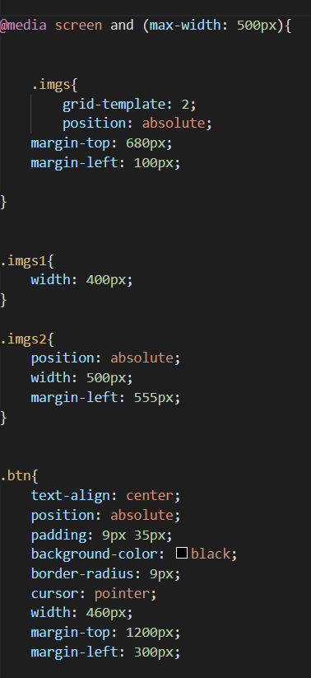
Media query

Slide 26
Thanks!

